Slide 1

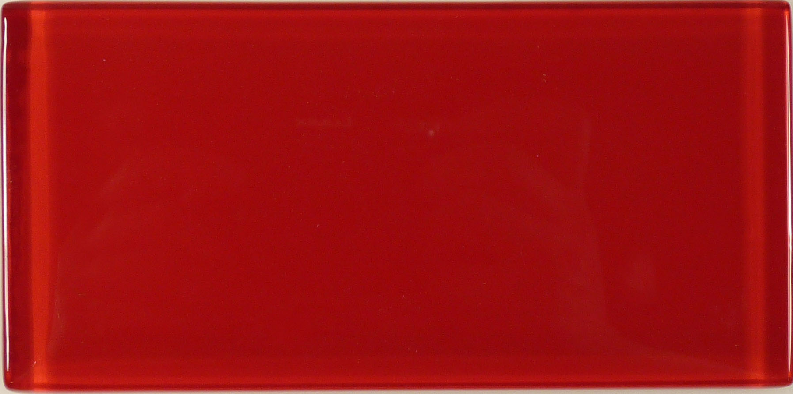

SOLID Principles
The First 5 Principles of Object Oriented Design
By Vinanti Thakur
(Application Architect /
Software Engineer)

Slide 2
SOLID
The first five object-oriented design (OOD) principles by Uncle Bob
SOLID stands for:
S - Single-responsibility Principle
O - Open-closed Principle
L - Liskov Substitution Principle
I - Interface Segregation Principle
D - Dependency Inversion Principle
31 January 2022

